Slide 1
Heart Disease Prediction
SCMT650 Applied Predictive Analytics
Group 5: Brandon Dupy, Arpita Deshmukh,
Yuqi Hu, Nick Keeley
Notes:
Arpita

Slide 2
Agenda
Business Problem
Data Overview
Data Analysis
Descriptive Statistics
Data Visualization
Predictive Models
Logistic | KNN | Random Forest | Support Vector Machines
Model Comparison
Conclusion
Notes:
Arpita

Slide 3
Business Problem
Predictive Analytics used to forecast future events.
Why use predictive modeling for prediction of heart diseases?
Objective - To utilize techniques and predictive models to classify a patient’s heart disease status with a high degree of accuracy.
False Negative Rate
Notes:
Arpita

Slide 4
Data Overview
UC Irvine Machine Learning Repository
Collected in 1988 [Cleveland OH, Hungary, Switzerland, and LongBeach VA]
Data Corruption - lost server node
303 Observations [297 after cleaning]
13 Attributes + Heart Disease Diagnosis [0,1]
Minimal Data Cleaning
50/50 test - train split used for all models
Notes:
Brandon

Slide 5
Data Variables
Patient | Medical Tests | Exercise Stress Tests
age Sex 0 female 1 male chest_pain [angina] 1 typical 2 atypical 3 non-cardiac 4 asymptomatic | rest_bp cholesterol fasting_blood_sugar (0 false, 1 true) > 120 mg/dl num_bloodvessels (0-3) Number of major vessels colored Determined using fluoroscopy thal (3,6,7) Genetic component Malformed red blood cells | resting_ecg 0 normal 1 abnormal 2 probable left ventricular hypertension max_hr {71-202} exang [exercise induced angina] 0: No, 1: Yes oldpeak {0.0-6.2} ECG: myocardial ischemia Plaque buildup in arteries leading to heart slope (1-3) From ECG - up, flat, down
Notes:
Brandon
LVH - enlarged heart, thickened pumping chamber

Slide 6
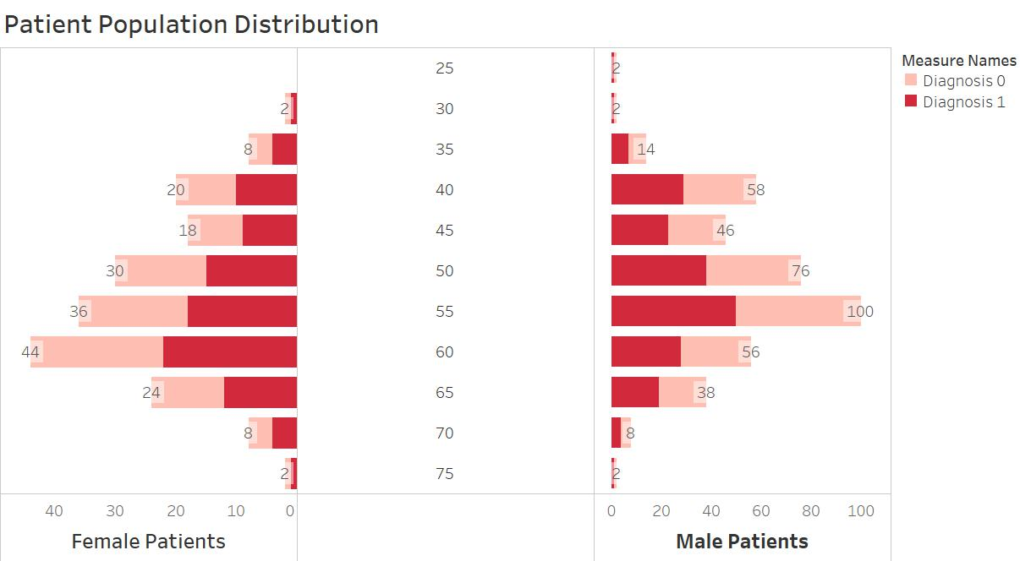
Data Analysis - Data Visualization
Female
71 Without HD
25 With HD
Male
89 Without HD
112 With HD
Notes:
Yuqi

Slide 7
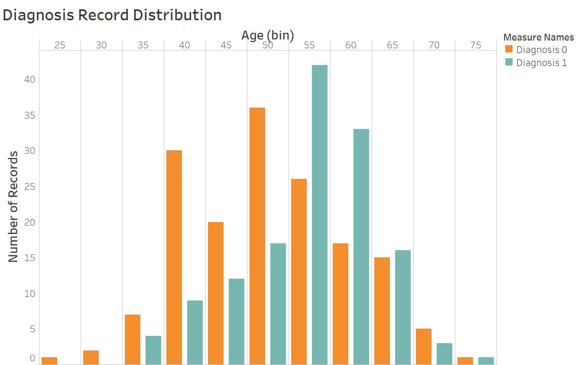
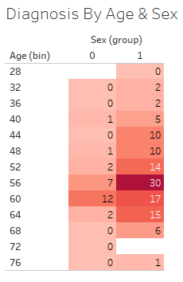
Data Analysis - Data Visualization
Notes:
Yuqi

Slide 8
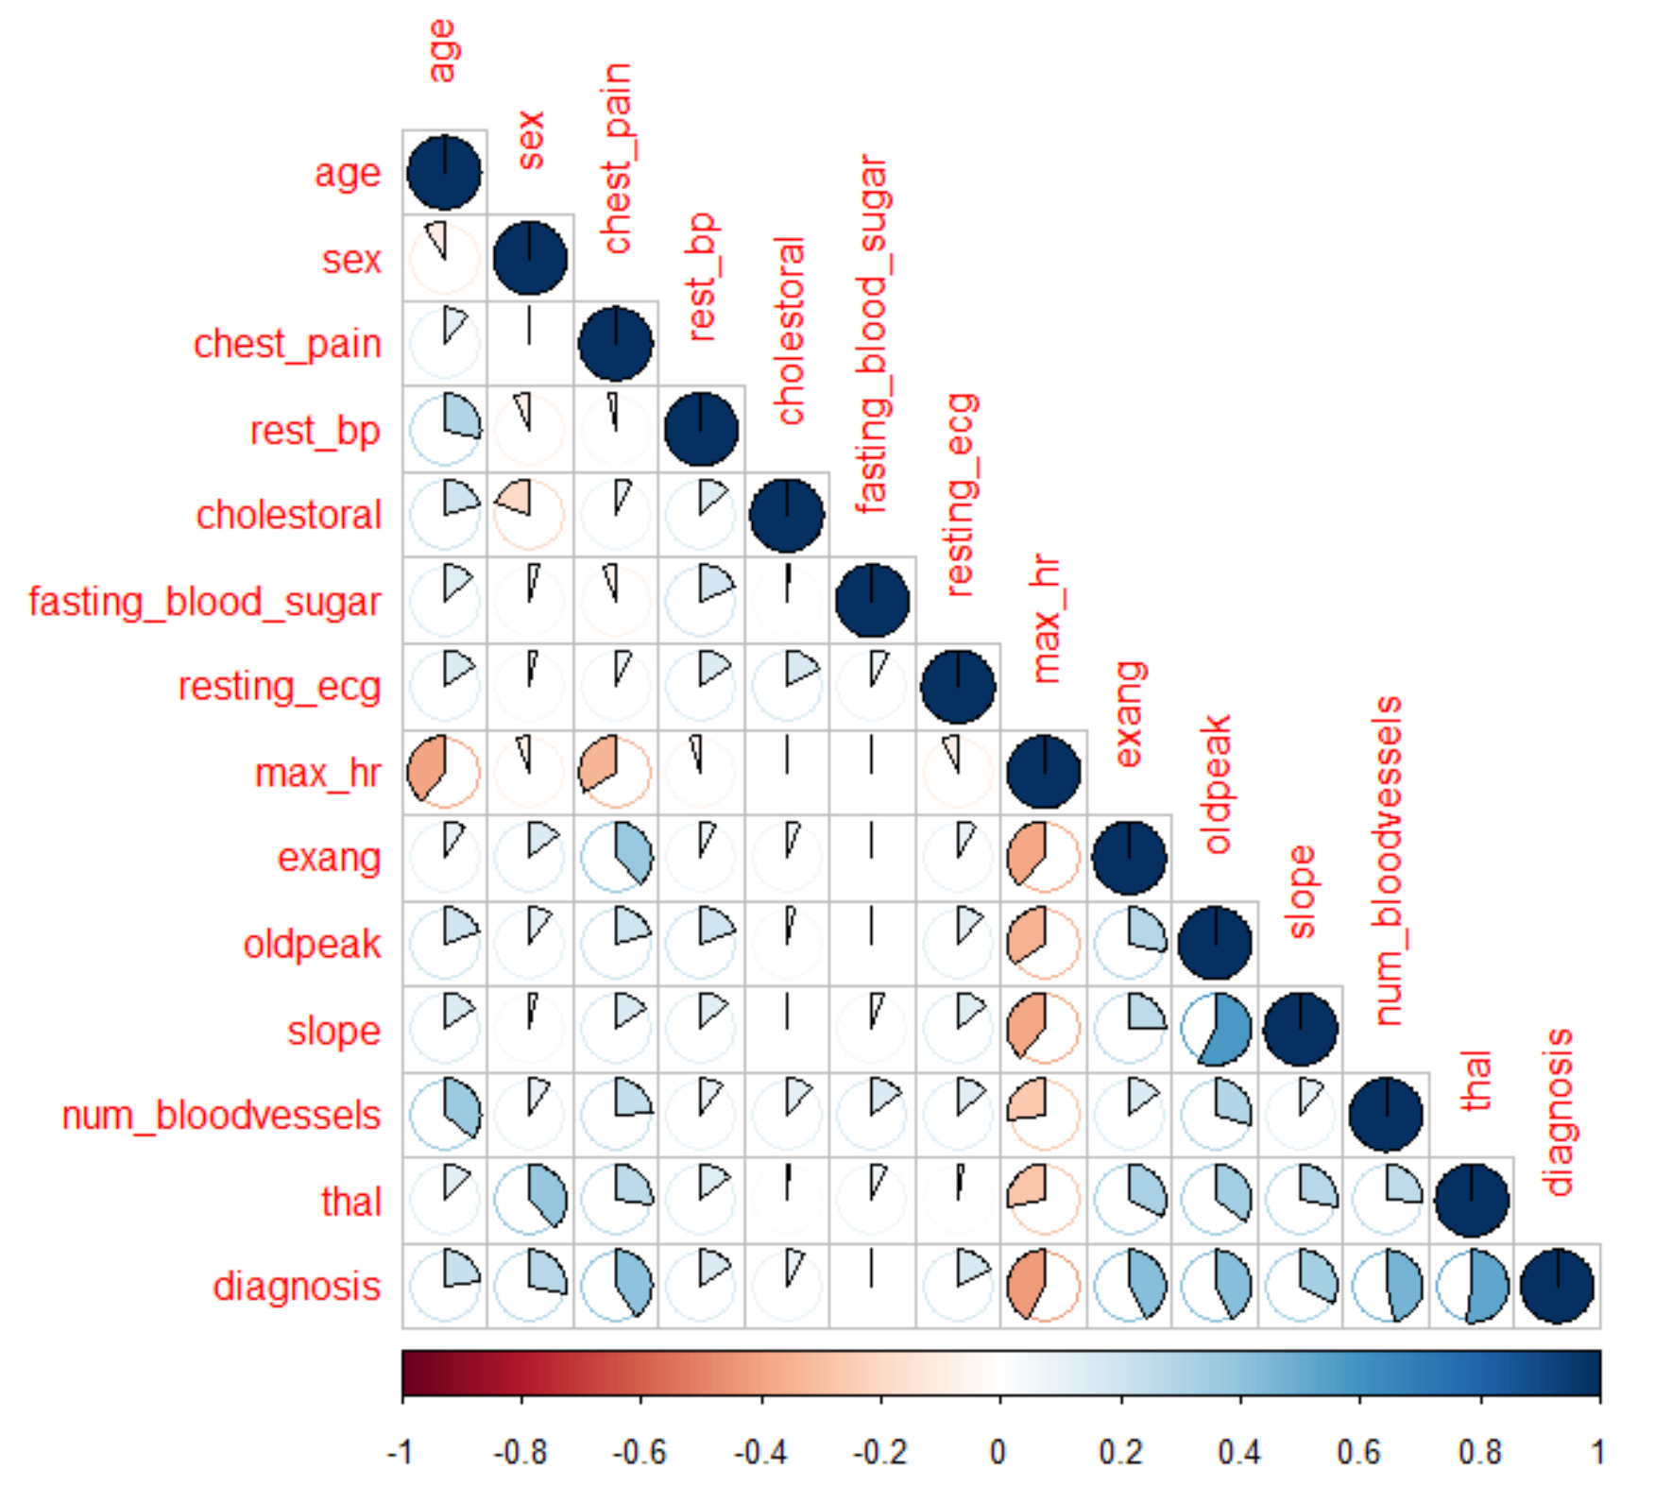
Data Analysis - Descriptive Statistics
Notes:
Brandon

Slide 9
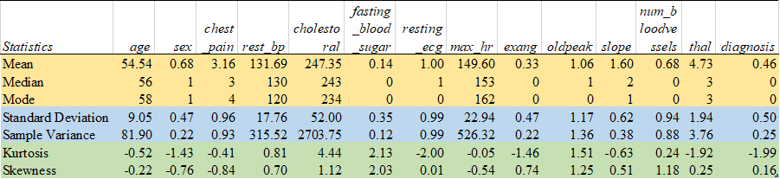
Data Analysis - Descriptive Statistics
Measure of central tendency: mean, median and mode
Measure of variability: variance and standard deviation
Measure of shape: kurtosis and skewness
Notes:
Yuqi

Slide 10
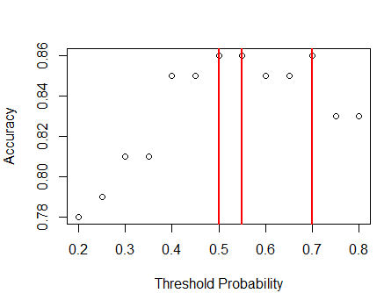
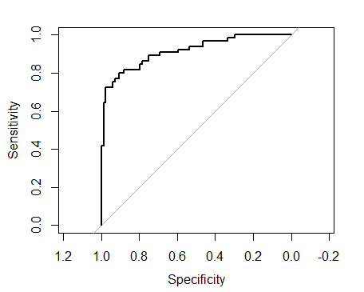
Predictive Models - Logistic Regression
Variable Selection
-> Stepwise Regression
Threshold Probability
ROC Curve
Accuracy = 86%
 | Actual
Predicted |  | 0 | 1
 | 0 | 76 | 8
 | 1 | 13 | 52
Notes:
Arpita

Slide 11
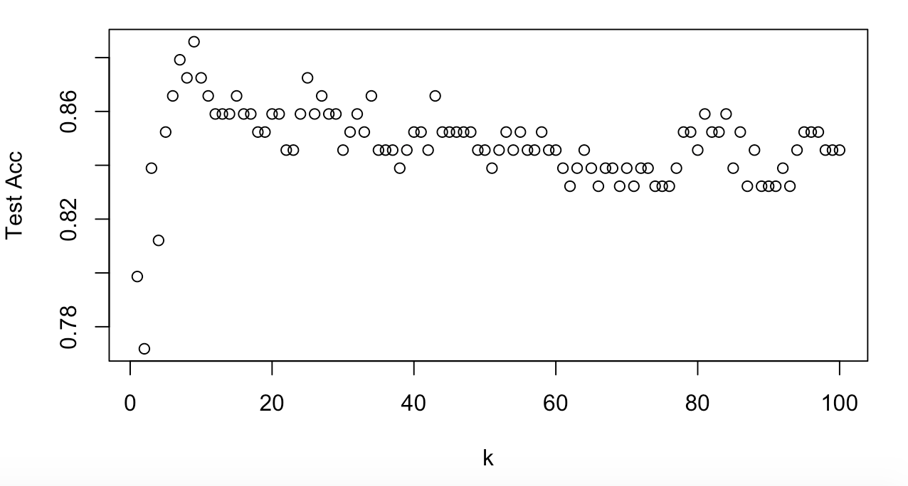
Predictive Models - KNN
Scaled variables through preprocessing
Iterated through 100 different values of K
K = 9 produces best model
Accuracy of 90%
 | Actual
Predicted |  | 0 | 1
 | 0 | 79 | 9
 | 1 | 5 | 56
Notes:
Nick

Slide 12
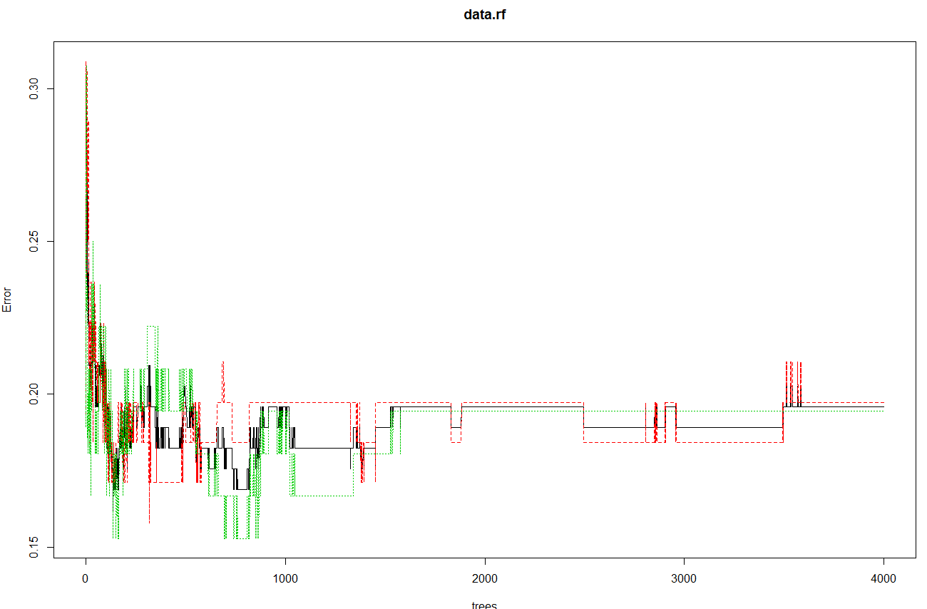
Predictive Models - Random Forest
Random Forest
Tuning
Number of trees = 4,000
Mtry = 2
Accuracy = 85% [Bagging Accuracy = 83%]
RF: Mtry=2 | Actual
Predicted |  | 0 | 1
 | 0 | 76 | 8
 | 1 | 15 | 50
Bagging | Actual
Predicted |  | 0 | 1
 | 0 | 75 | 9
 | 1 | 17 | 48
Notes:
Brandon

Slide 13
Predictive Models - SVM
Linear kernel
Best tuned value for cost: 5
Support vectors: 55
Accuracy is 0.83; Misclassification rate is 0.16
Radial kernel
Best tuned value for cost: 5; Best gamma: 0.5
Support vectors: 146
Accuracy is 0.69; Misclassification rate is 0.30
Polynomial kernel
Best tuned value for cost: 5; Best gamma: 3
Support vectors: 92
Accuracy is 0.81; Misclassification rate is 0.18
v
 | Actual
Predicted |  | 0 | 1
 | 0 | 76 | 17
 | 1 | 8 | 48
 | Actual
Predicted |  | 0 | 1
 | 0 | 44 | 6
 | 1 | 40 | 59
 | Actual
Predicted |  | 0 | 1
 | 0 | 67 | 11
 | 1 | 17 | 54
Notes:
Yuqi

Slide 14
Model Comparison
Accuracy and False Negative Rate used as main criteria
False Negative Rate important with business problem
KNN with K = 9 producing best results
 | Accuracy | False Negative Rate
Logistic | 86% | 15%
KNN (K=9) | 90% | 6%
Random Forest (mtry=2) | 85% | 17%
SVM (Linear) | 83% | 10%
Notes:
Nick
FalseNegRate = 100 * [ FalseNeg / (TruePos + FalseNeg)]

Slide 15
Conclusion
Predictive analytics can be incredibly useful in health care industry
Specifically in diagnosis
These models are reliable tools for disease diagnosis
Further steps needed to improve diagnosis accuracy
Collection of more data
Research of other possible predictors
Notes:
Nick

Slide 16
Thank you!
Questions?

